Slide 1

AUTOMOBILE MARKET ANALYSIS PROJECT-PART1
PRIYANKA MARURI

Slide 2
INTRODUCTION
In the current Automobile market, every car manufacturer is facing an evolving market where drivers are becoming increasingly eco-friendly.
Consumers are now placing a higher value on vehicles that prioritize environmental sustainability, fuel efficiency, and safety, alongside the traditional focus on performance.
In order to analyze Data analytics has become a crucial tool in this new market environment.
In this project Smith a data analyst is responsible for analyzing a comprehensive car dataset to identify potential new models to launch.
A car dataset has given that contains all the details and need to performed various tasks to arrive to conclusion.

Slide 3
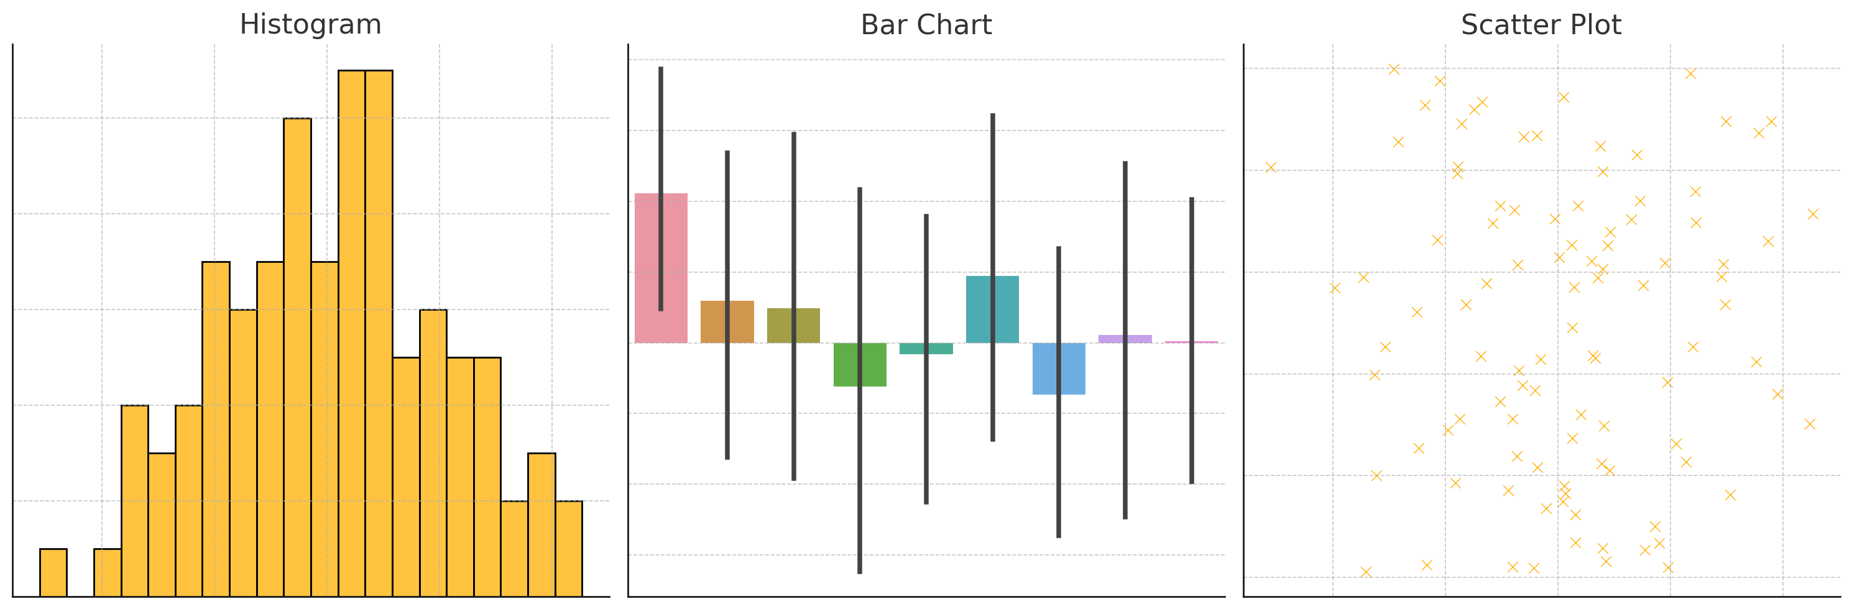
Objectives
The objective of this project is to analyze car dataset provided in sprint6 and sprint7.
The main focus of this project is to evaluate the visualizations generated during sprint6 and sprint7.

Slide 4
Sprint6---Question 1
Identify the top 10cars with highest mileages per gallon . Also, the name of the manufactures.
Select make and model and
City mileage columns.
Using pivot table identify
the top 10 car manufactures
Baleno | Suzuki
Ciaz | Suzuki
Dzire | Suzuki
E20 plus | Mahindra
Grand I10 Prime | Hyundai
Kwid | Renault
Nano Genx | Tata
S-Cross | Suzuki
Tiago | Tata
Tigor | Tata
INTERPRETATION: From question1 we have identified the Top 10 cars with the highest mileage per gallon and also name of the manufactures of such cars.

Slide 5
Sprint6---Question 2
Identify the top 3 manufactures with the highest number of cars of the hatchback body type.
Select make and model and
Body type columns.
Using pivot table identified
the top 3 car manufactures
Of body type.
Interpretation : From question 3 we have identified that SUZUKI , TATA,HYUNDAI are the top 3 manufactures of hatchback body type.
Body_Type Hatchback Make | Count of make
Hyundai | 46
Suzuki | 96
Tata | 36
Grand Total | 178

Slide 6
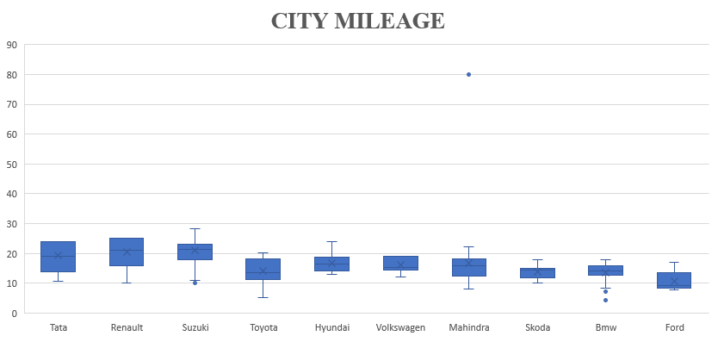
Sprint6---Question 3
Compare the mileages of cars produced by all the manufactures and perform outlier analysis.
Select city mileage
and make columns.
Using box plot identi
-fy the outlier .
INTERPRETATION: From question 3 we have identified the outlier of the manufactures. Mahindra and BWM has outlier.

Slide 7
Sprint6---Question 4
Present the relationship between : 1) Displacement and city mileage
2) Fuel tank and city mileage
Select displaceme
-nt and city mileage
and fuel tank columns.
Using scatter plot
identified that both the
displacement andCity
Mileage & city
Mileage and fuel tank.
INTERPRETATION: From question 4 identified that both has negative relation

Slide 8
Sprint6---Question 6
Identify a car that would be best for adventurous drives.
Select make ,model and displace
ment , fuel tank , height and
width, length, body type and ground
clearance columns
INTERPRETATION: So BMW(X4) IS best car for the adventurous drives
Make | BMW
Model | X4
Displacement | 2993
Fuel tank capacity | 68
Height | 1621
Length | 4752
Width | 1918
Body type | SUV
Ground clearencce | 498mm

Slide 9
Sprint6---Question 8
The car manufactures decides to launch 2 types of cars.
1)Compact city car(Primarily for car usage)
2)Family car(Primarily for long distance travel)
Identify the potential competitor cars for the two types of cars state above.
Select make and model
and city mileage and high
Way mileage, Child safety
Lock ,Bluetooth columns
INTERPRETATION: Based on above conditions the SUZUKI and TATA cars would be best for city usage and long distance travel.
MAKE | MODEL
Suzuki | Baleno
Tata | Nan Genx

Slide 10
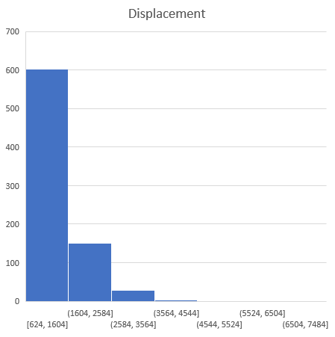
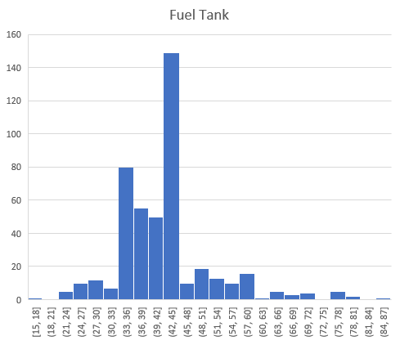
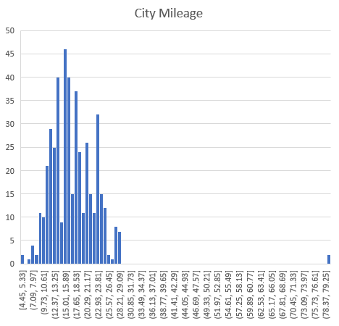
Sprint6---Question 9
Identify outlier from the following columns using histogram : Displacement (Bin size :980) , City mileage(Bin size:0.88),Fuel tank capacity(Bin size:3).Remove the outlier from the dataset.
The above charts are with outliers.

Slide 11
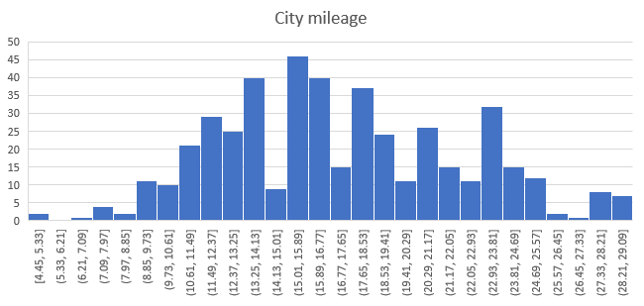
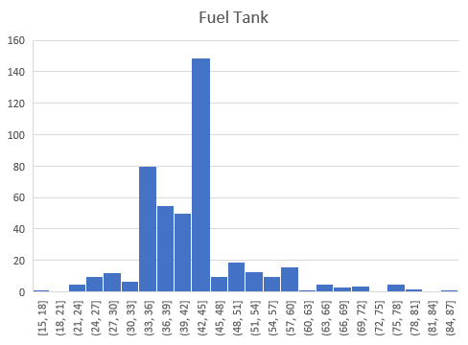
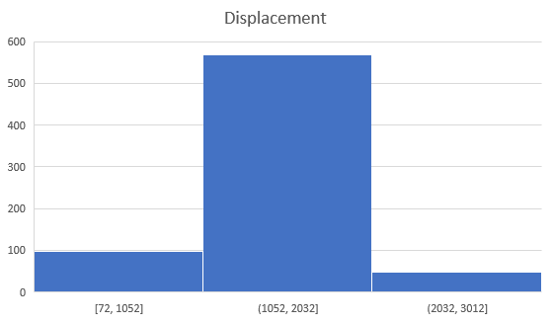
Question 9(cont.): The below charts represents the without outliers of displacement and city mileage and fuel tank capacity.

Slide 12
AUTOMOBILE MARKET ANALYSIS PROJECT-PART2

Slide 13
Sprint7---Question1
Identify the two manufactures who offer the widest range of cars variants .Use chart to present the output ,capturing the number of car variants under each body type for two manufactures identified above.
Select make ,body type
Columns.
Using pivot table identify
the top 2 manufactures.
INTERPRETATION : From question 1 identified the top 2 manufactures the are SUZUKI and HYUNDAI.
MAKE | BODY TYPE | COUNT
SUZUKI | Crossover | 4
SUZUKI | Hatchback | 97
SUZUKI | MPV | 14
SUZUKI | MUV | 4
SUZUKI | Sedan | 31
SUZUKI | SUV | 13
Total |  | 163
HYUNDAI | Hatchback | 43
HYUNDAI | MPV | 1
HYUNDAI | Sedan | 44
HYUNDAI | SUV | 42
Total |  | 130
Grand total |  | 293

Slide 14
Sprint7---Question 4
Convert categorical variable to numerical codes
Select fuel type column
INTERPRETATION : From question4 illustrated that categorical variables are converted into numerical code and using pivot table determined the count of the numerical codes of categorical variables.
Fuel type | Count of code
CNG | 15
CNG + Petrol | 6
Diesel | 366
Electric | 12
Hybrid | 3
Petrol | 385

Slide 15
Sprint7---Question 5C
Segment cars into categories like “high” , ”moderate “ , “low” and analyze the distribution feature of within each category.
INTERPRETATION : From question 5 determined the average combined mileage into categories like high and low and medium and plot the bar chat.
Category | Count of category
HIGH | 119
LOW | 22
MEDIUM | 144

Slide 16
Conclusion
AUTOMOBILE MARKET ANALYSIS PROJECT-PART1:
The conclusion of project1 is that identified the top 10 cars based on mileage and visualize the task in bar graph and next identified the top 3 manufactures of hatchback body type. From that Suzuki , tata , Hyundai car has highest number of car of hatchback body type.
And next visualized the mileage of cars produced by all manufactures and performed the outlier and Mahindra car has the outlier.
And moreover BMW car is best for the adventurous drives and Suzuki and tata cars are the best suitable for the city usage and long drives.
AUTOMOBILE MARKET ANALYSIS PROJECT-PART2:
The conclusion of project 2 is identified the top two manufactures that has widest range of cars and visualize the top two manufactures.
And also identified categories like high and low and medium .
And furthermore determined the categorical variables into numerical codes like 1 , 2 etc…

Slide 17
THANK YOU

